Slide 1
Kansas Fights Addiction Request For Proposals Updates
6/9/23

Slide 2
Recap Treatment RFP Applicants
71 applications from 62 different organizations
All congressional districts received multiple applications
All priority areas and strategies received 2+ applications

Slide 3
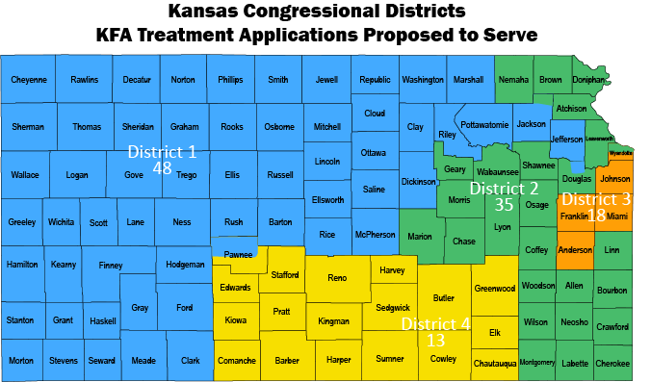

Slide 4
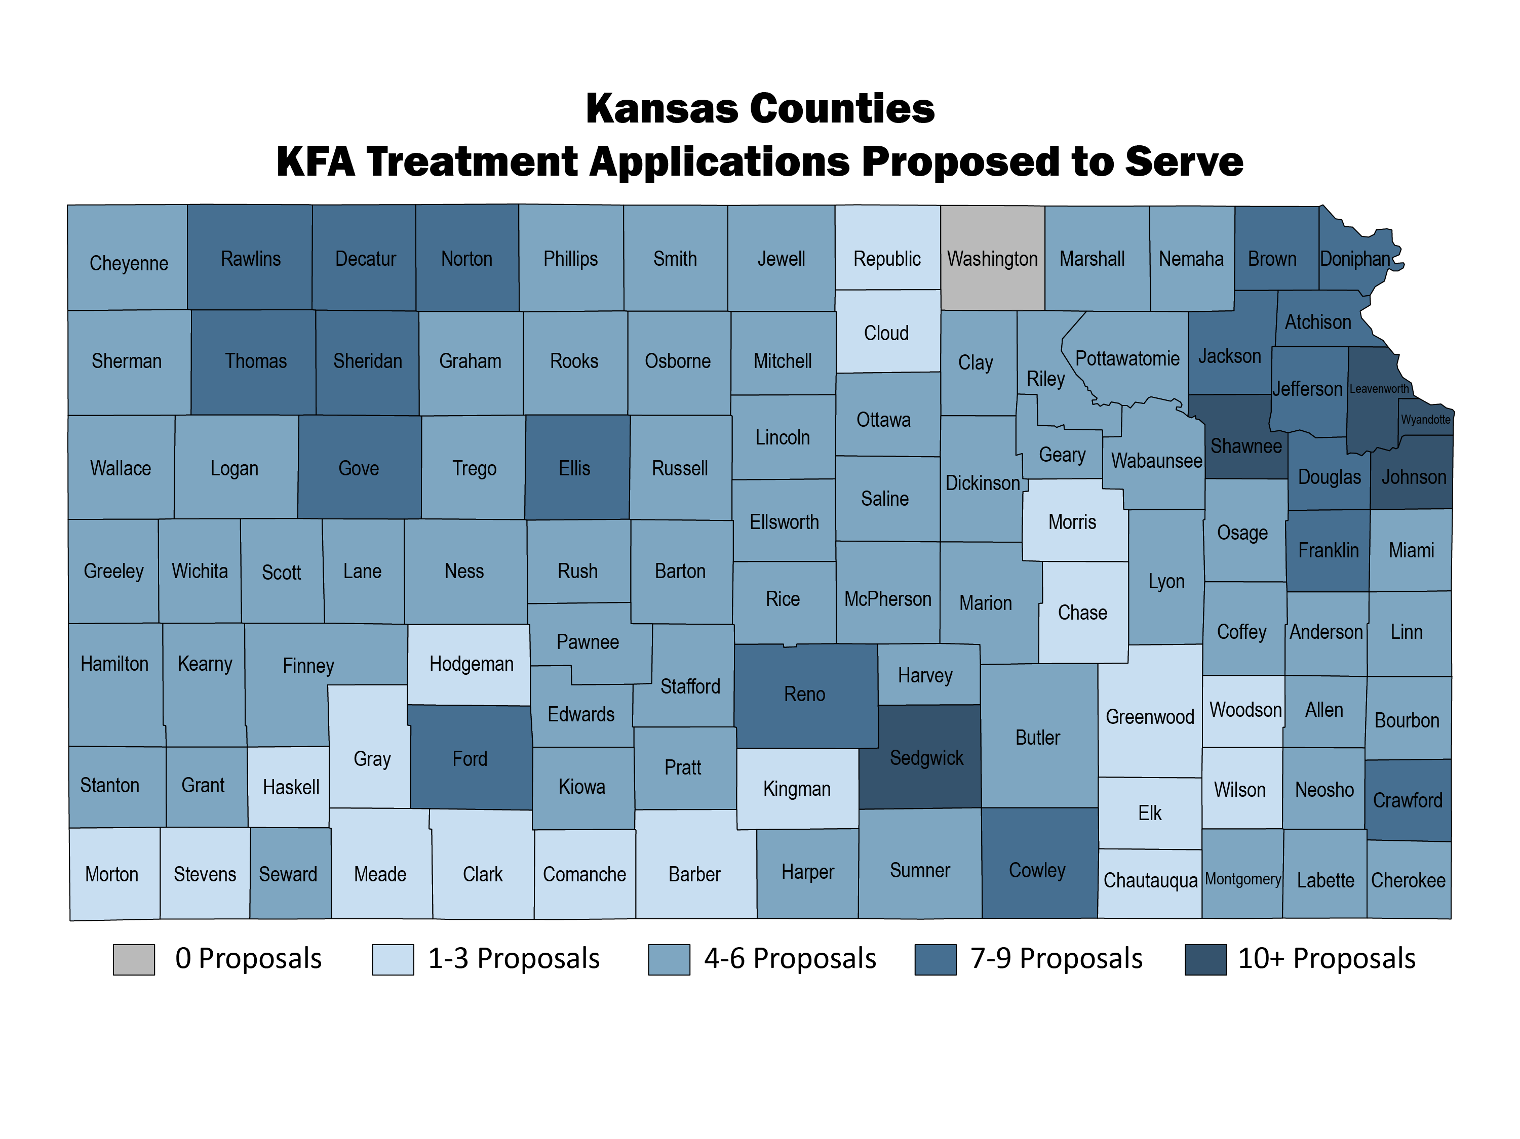
*16 propose statewide coverage

Slide 5
Prevention RFP Update
67 Confirmations of Intent
Application Closes June 23rd
Notes:
48 confirmations as of 5/30
Webinar 1 = 32 attendees
Webinar 2 = 29 attendees

Slide 6
Moving Forward RFP 1, 2, & Needs Assessment Estimated Timelines
September 2024-November 2024
June – July 2023: Treatment Initial Review & Board Report Development
6/23 – Prevention RFP Closes
7/28: Submit Treatment Summary Reports to KFA Board
~July - Release of Needs Assessment RFP
July-August Prevention Initial Review & Board Report Development
8/11: KFA Board Treatment Applicant Review/ Selection
8/25: Submit Prevention Summary Reports to KFA Board
9/1: Treatment Awardee Notification
9/8: KFA Board Prevention Applicant Review/ Selection
Sept/Oct Needs Assessment vendor selection
10/2: Prevention Awardee Notification
Sept-Nov: All 3 Grant Periods Begin (Treatment, Prevention, Needs Assessment)
Treatment, Prevention, and Needs Assessment Grant Periods Estimated to End
October
2023
September
2023
August
2023
July
2023
June
2023
Ongoing: updates to KFA board on all grants

