Slide 1
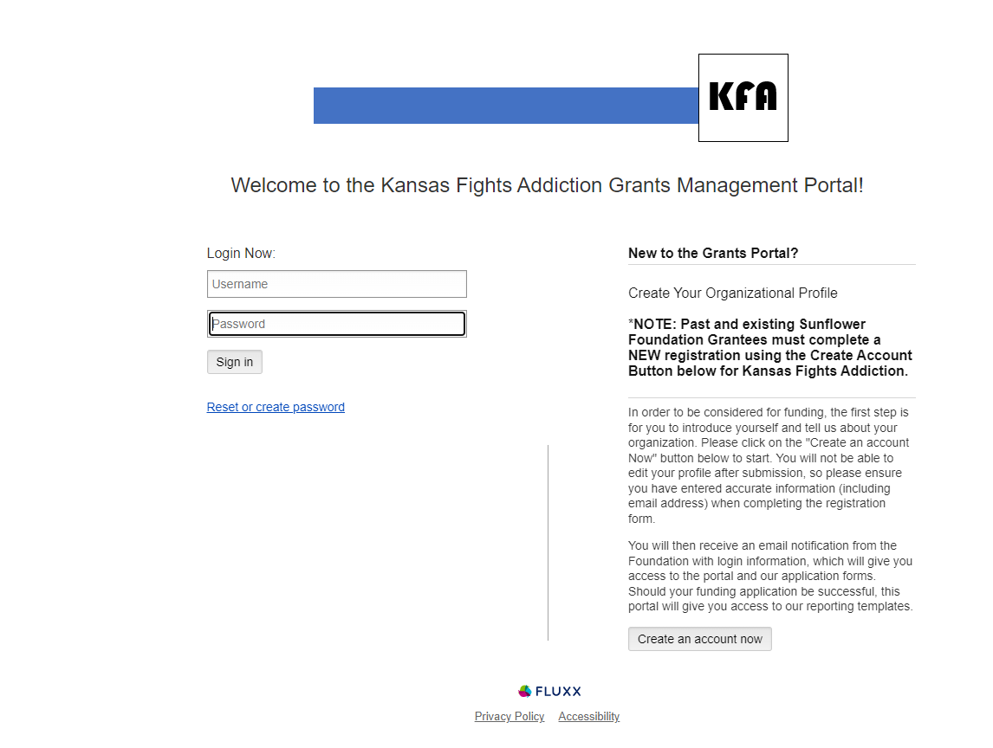
Notes:
Good morning everyone, my name is Kelli Mark and I am the Grant Manager at the Sunflower Foundation.
I am going to take a few minutes this morning to walk you through the board portal we have developed in our online Grants Management system, Fluxx.
If you have any technical difficulties with trying to access Fluxx or with the board portal, please reach out to me, my contact information is listed on the Sunflower Foundation website.
In order for you to have access to the Board Portal, I will create an account for each of you in Fluxx.
Your user name is going to be your KFA Board member email. You will get an email from Fluxx with your username and temporary password with a link to the Fluxx login screen, which is shown on this slide.
Enter your user name and password, then click the “reset or create password link” to create your new password. Then, use your username and new password to login.

Slide 2
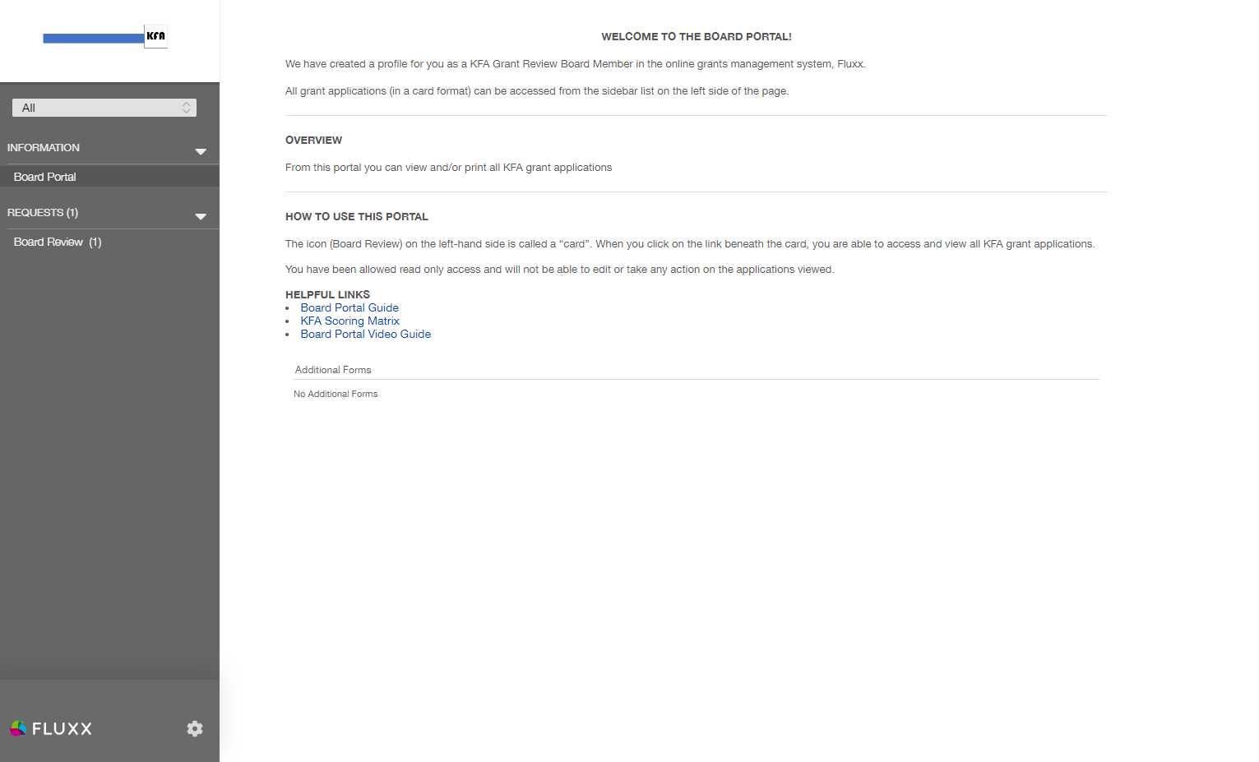
Notes:
When you login, you will be taken immediately to the board portal. The home page of the board portal is shown on this slide.
We have placed some helpful links on the portal home page for your use. There is a PDF Board Portal Guide you can access, as well as a Board Portal Video.
You can also find the KFA scoring matrix, which you can download to reference as you are reviewing applications.
In the portal, you action buttons are located in the left-hand side bar.
Once grant applications are moved to “board review” they will show up in the portal. You can find them by clicking on the Board Review tab. You will be able to tell how many applications are available for review by the number that is located next to the Board Review Tab. In this example, there is a 1, as I have only loaded 1 test application.

Slide 3
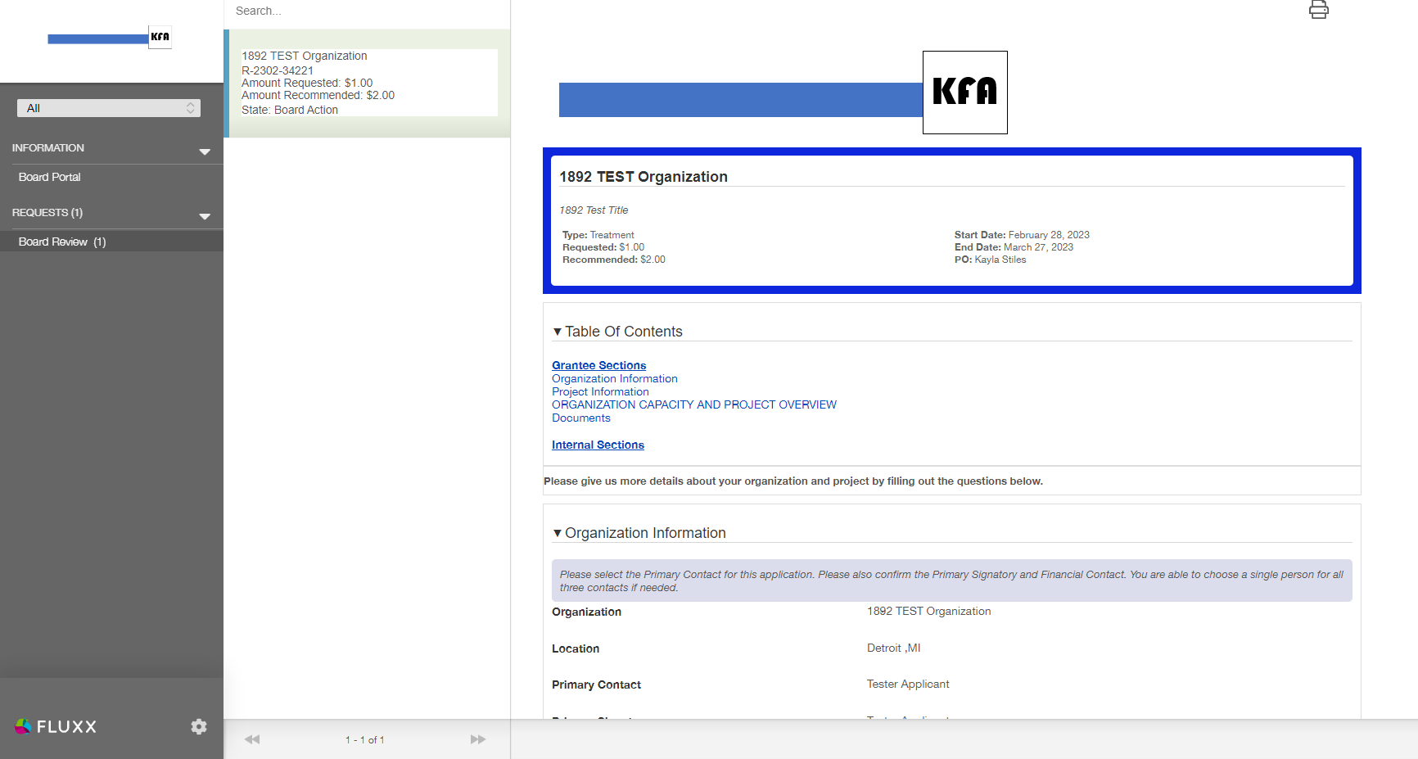
Notes:
When you click the board review tab, all of the application thumbnails will open in the viewing window to the right. All the applications available for review will show up in a vertical list.
Click on the application you wish to view, and it will open up in read only mode.
You can view all of the grantee sections of the applications, including the budget workbook that was uploaded with the application.
You can also print applications from here if you would like to view them on paper.
Clicking the board portal tab in the left hand sidebar will take you back to the board portal homepage.

Slide 4
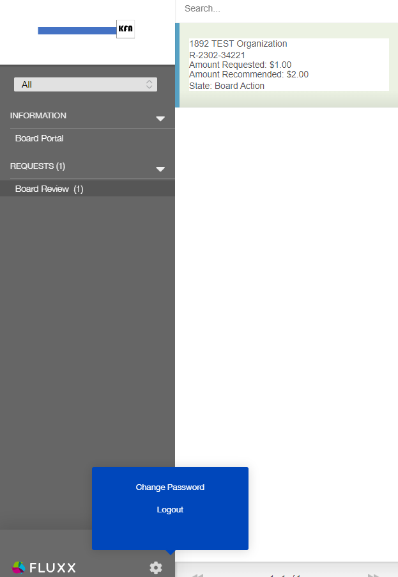
Notes:
The last thing I have to show you today is located at the bottom of the left hand side bar.
If you click on the gear located there, a popup will open that will allow you to change your password, or log out of Fluxx.
That’s all I have for your today, but I would be happy to answer any questions that you may have.
Thank you!

